Slide 1
Lessons from Microsoft IT’s Accessibility Journey Michael Vanderhyde Rajesh Kalidindi Heather Dowdy

Slide 2
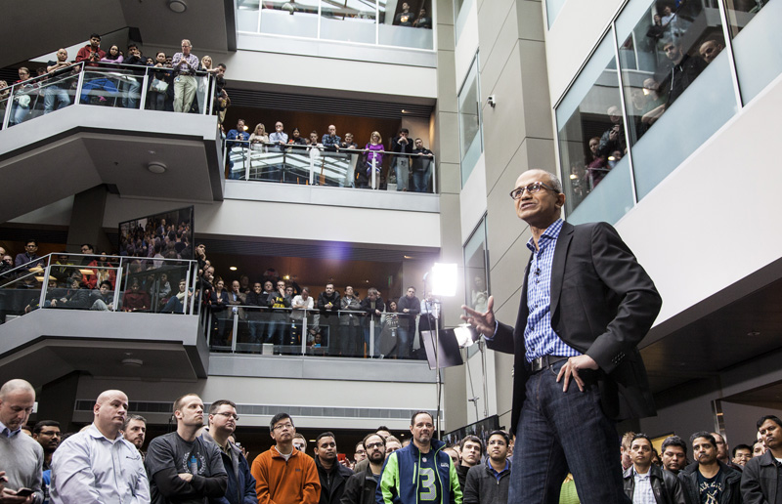
Who is going on the journey?
Federated model for driving accessibility
Several thousand people and many teams
Multiple development resource models
Multiple development approaches

Slide 3

How did we start our journey?
We got gas money
We had sponsorship
Established accountability with group leaders and day to day leads
We packed for the Journey
Established Inventory
Criteria for scope – incorporated into inventory systems
Planned our Journey
Established Priorities and Targets
Established criteria for prioritizing our portfolio
Set initial deadlines by priority
Established individual compliance targets

Slide 4
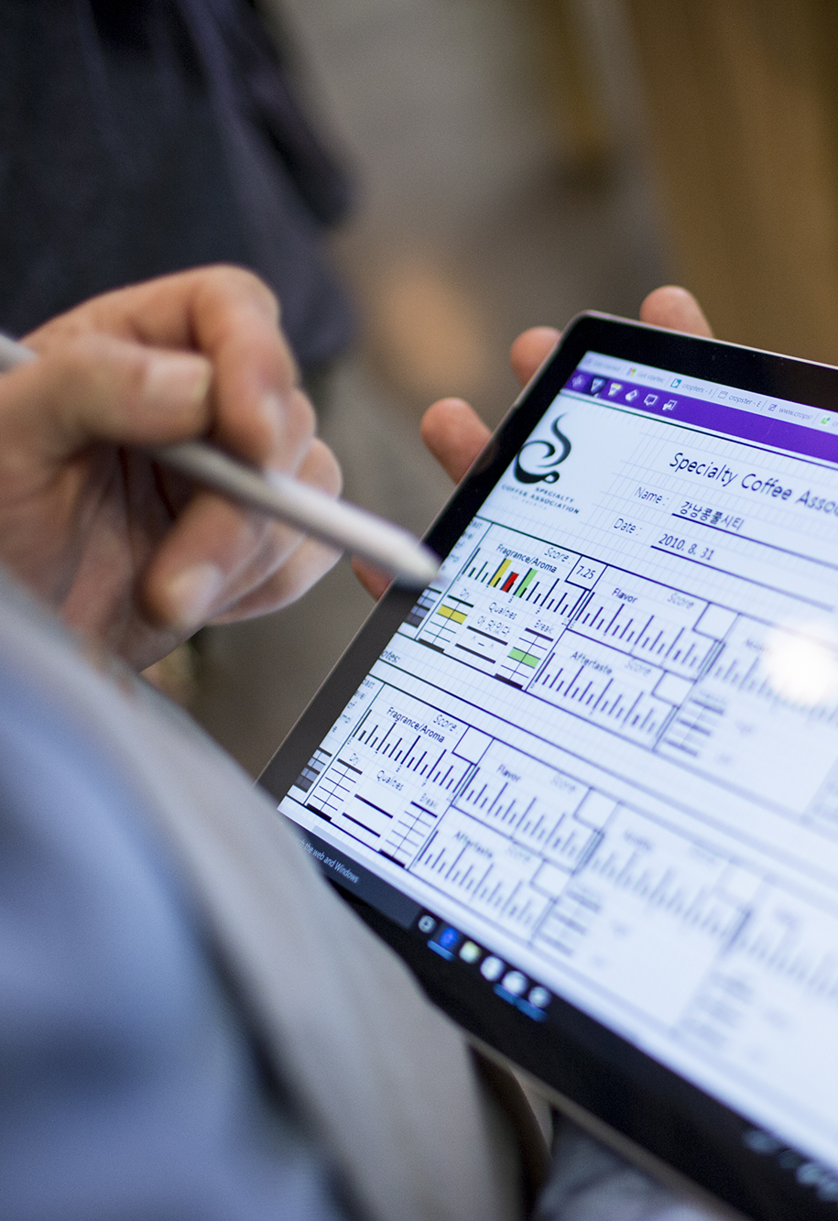
How did we start our Journey? - Continued
We consistently reviewed our Journey progress with passengers
Tracking and reporting established and reviewed with Org and Accessibility Leads regularly
We hired a driver who knew how to drive a manual shift
Drive assessments and remediations
Accelerated understanding issues by contracting with assessment service
Provided detailed bugs data to teams
Verified and validated remediations

Slide 5

We need a new car to accelerate our Journey
Accessibility Leads role is changing
More than just a coordinator an expert
More audits less fewer assessments
Shifting our accessibility service to focus more on auditing assessments done by teams
Integrating accessibility into Dev Workflow
Guidance and ques during coding (VSTS Plug-in)
Testing tools (scanning code)
Drive more knowledge
Coaching service
Required training

Slide 6

Who is our new passenger?
Supplier solutions
Specialized expertise
Deliver faster

Slide 7
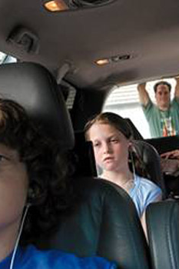
What are the new passenger challenges?
Commitment
Skills gap
Timeline differences
Different testing methodology
Microsoft Internal org is complex

Slide 8
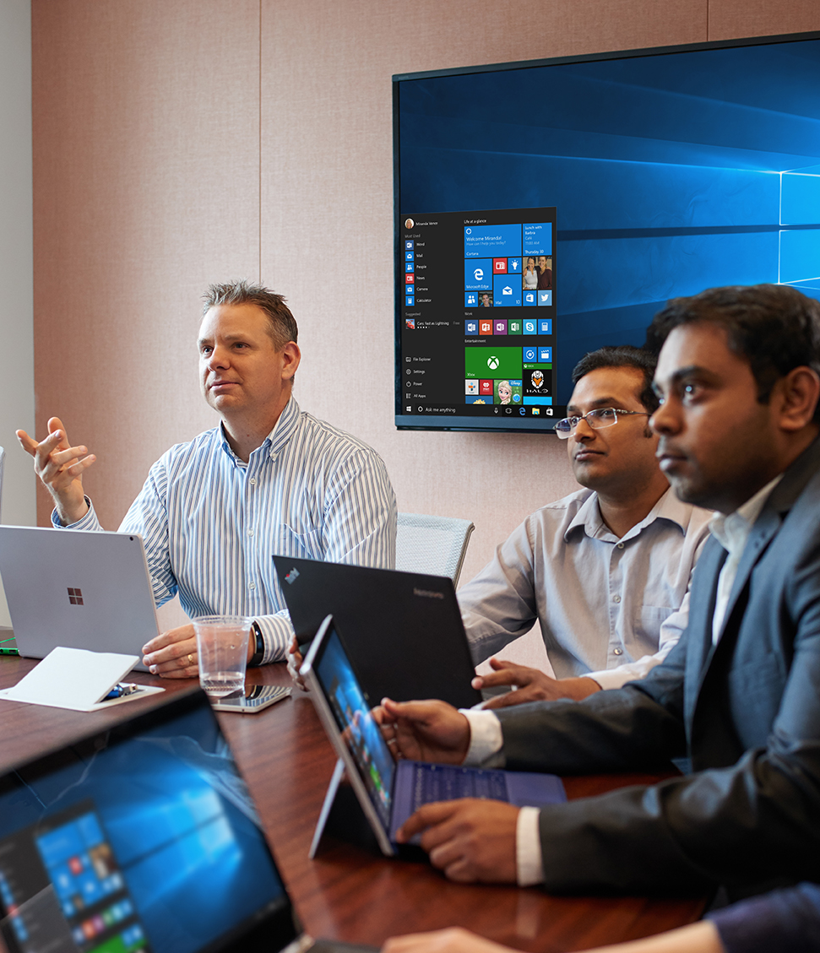
Making an acceptable passenger agreement
Clarify expectations
Evaluate capability
Make an informed decision
Make it count

Slide 9
How do we execute the passenger agreement?
Establish accessibility POCs on both sides
Clearly define the scope and acceptance criteria
Based on review of WCAG compliance documentation and gaps at the feature level
Integrate accessibility into the dev lifecycle
Test cases based on people with disabilities and the latest assistive technology
Ongoing testing across multiple lifecycles / milestones
Manage risk and approvals
Prioritization and tradeoffs related to user impacts, schedule, and cost

Slide 10
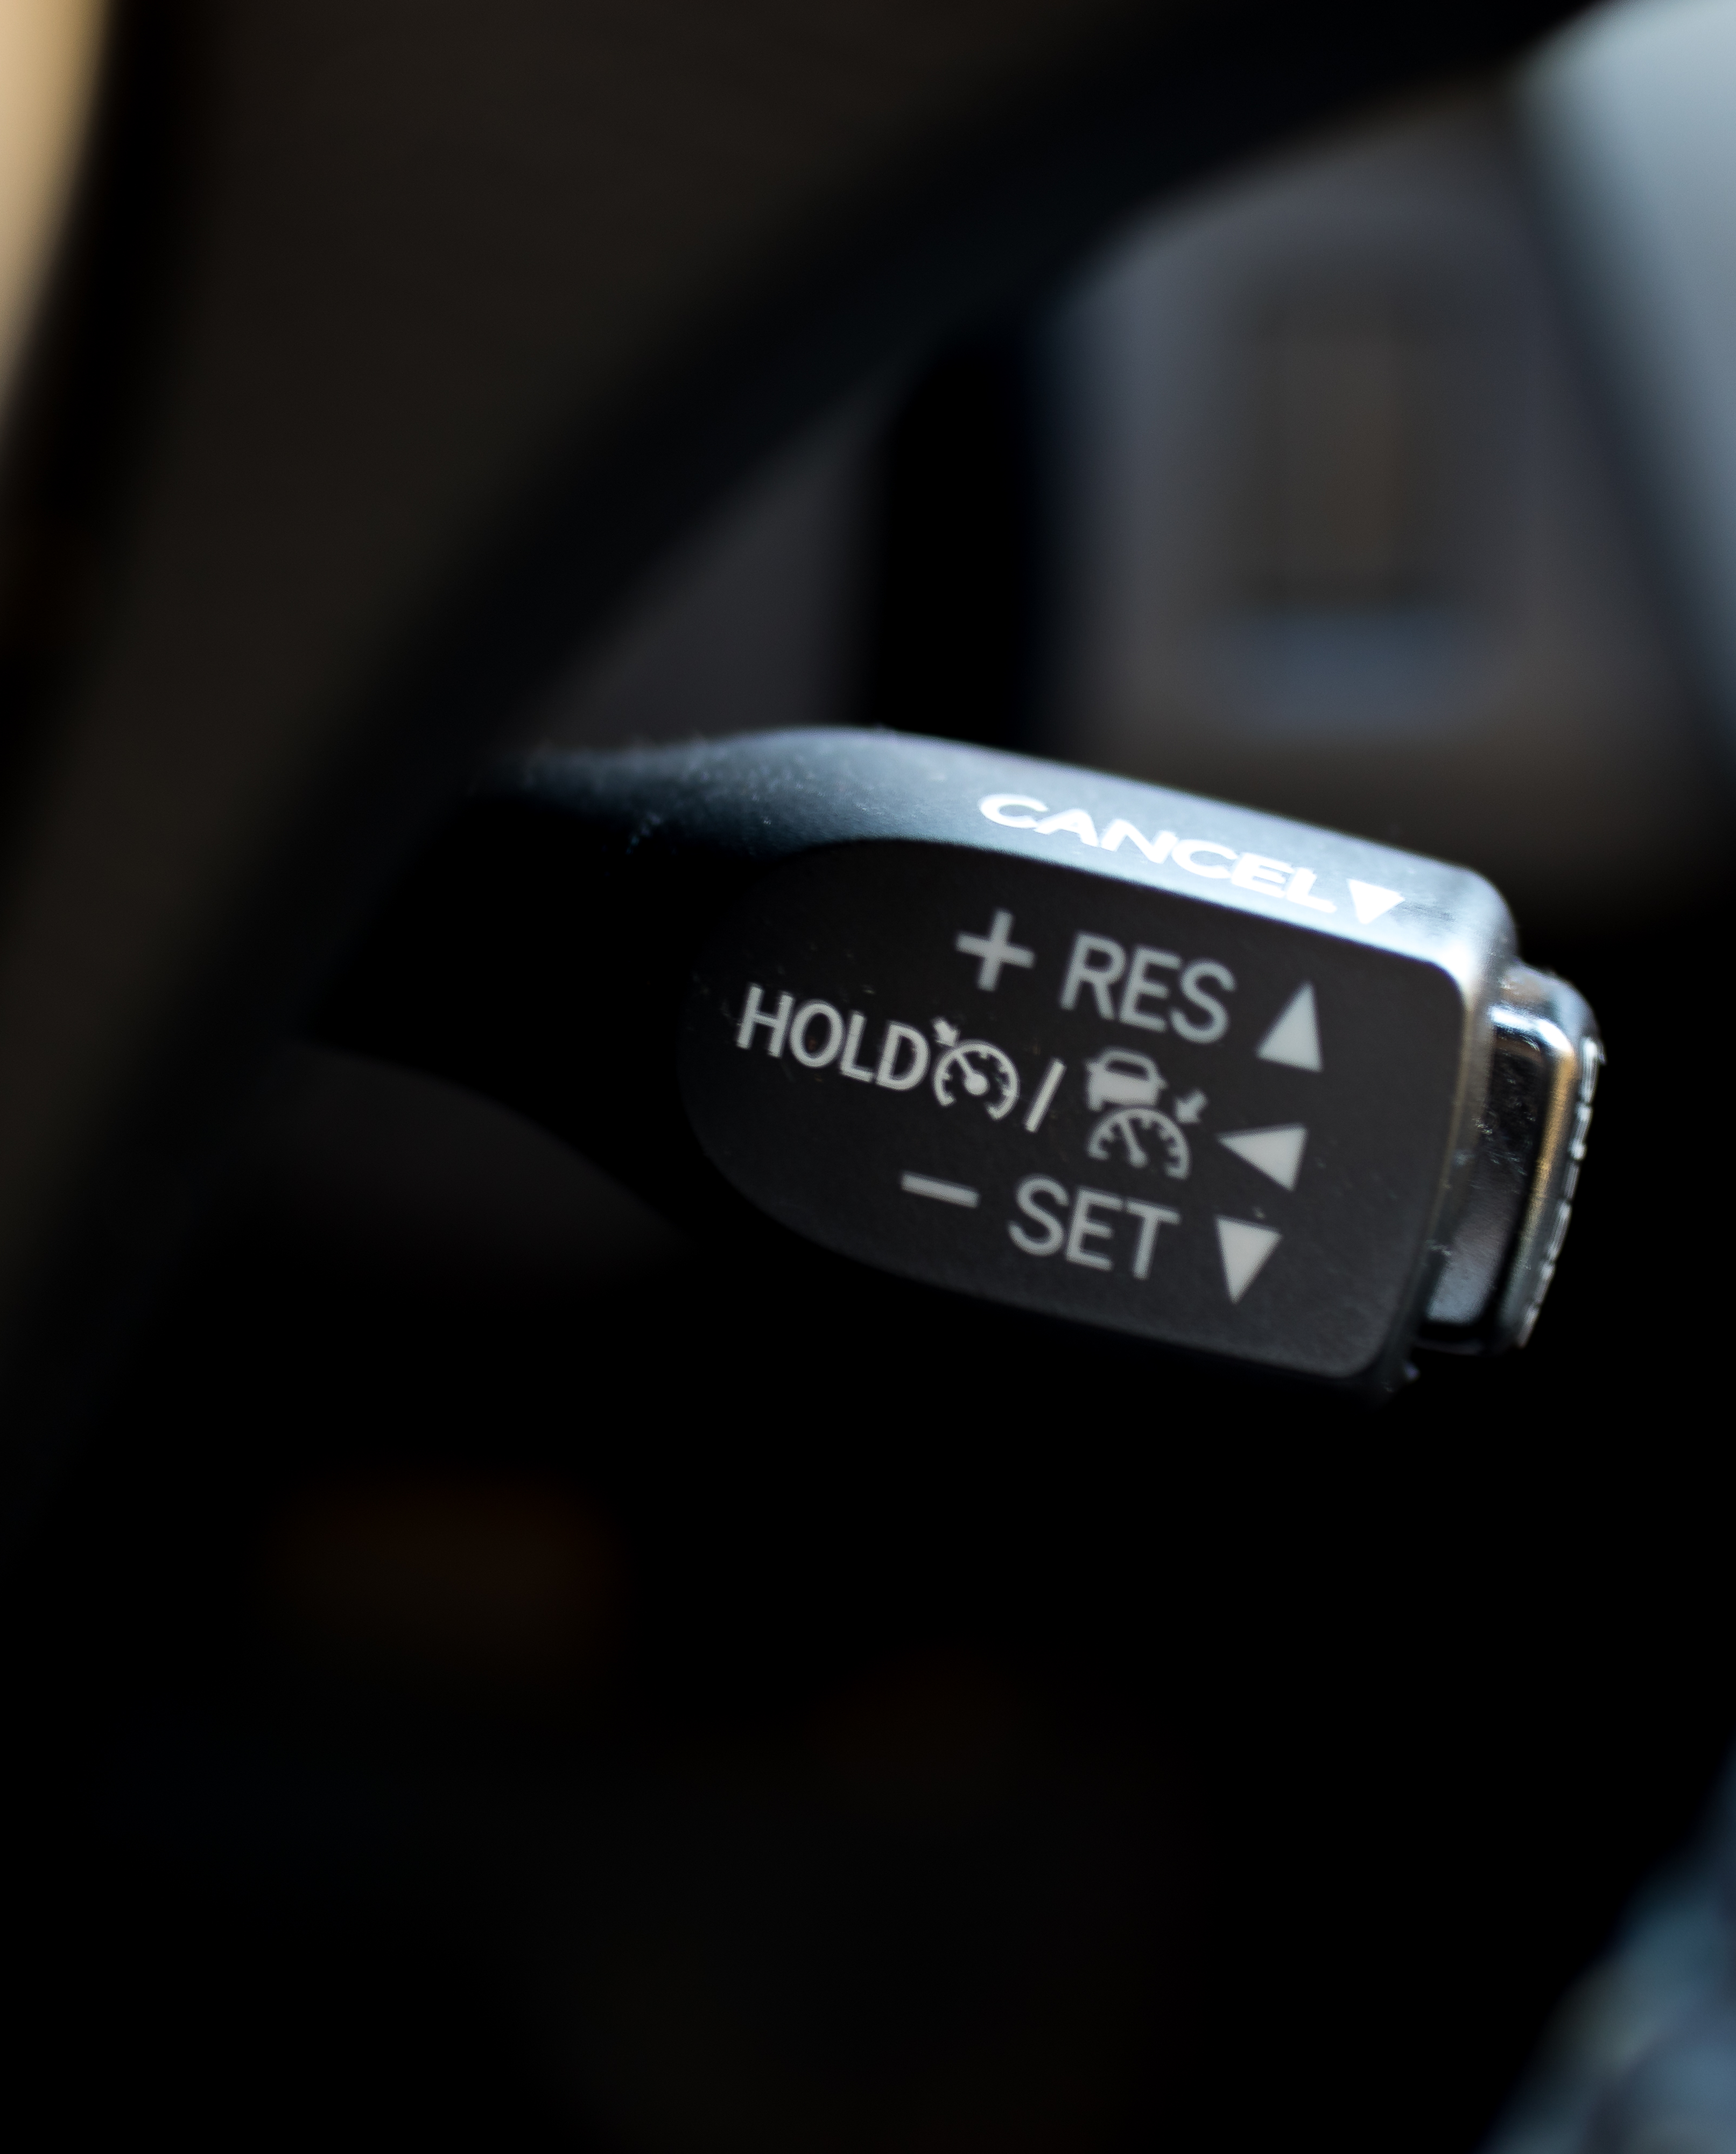
Wait, no cruise control?
Ongoing engagement with Stakeholders
Leaders, Leads, and Suppliers
Continual focus on Accessibility
Ongoing feedback
Continual customer feedback (e.g., eDAD)
Ongoing reviews to mitigate regression
Periodic checkups (ex: every 6 months)
Standardize and integrate
Continual Training
New employees, existing employees, and new suppliers

Slide 11
Resource Links
Microsoft at CSUN
Aka.ms/CSUN2018
Answer Desk for Accessibility Support
aka.ms/eDAD
Microsoft Accessibility Overview
Microsoft.com/Accessibility
Microsoft IT Showcase
https://www.microsoft.com/itshowcase

